Slide 1
TASK 04
USER & SYSTEM REQUIREMENTS
24. März 2015
Team Green: MR, NM, RZ, SB, TS

Slide 2
User requirements definition
Login page
Single landing page for the list of patients (i.e. Dashboard)
Possibility to
Open Appointments
Open/Change patient data
Open/Change/Add medication
Open biography
Open/Change caregivers
Medication search in Swissmedic
Fulltext search on
All properties
Single properties

Slide 3
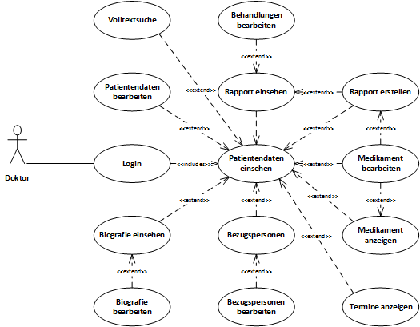
Use Case Diagram

Slide 4
Use Cases I - Check Patient Information
Involves Doctor and System itself
Doctor selects the patient
System retrieves the data and shows to a Doctor
Following exceptions may occur
Connection failure
Session timeout

Slide 5
Use Cases II - Add/Edit Medication
Involves Doctor and System itself
Doctor decides to add/change a medication
Add
Search / Select from drop-down list
Specify interval and dosing
Change
Edit a desired medication entry via editable fields
Save
Following exceptions may occur
Connection failure
Session timeout
Non existing medication selected
Dose/interval exceeded

Slide 6
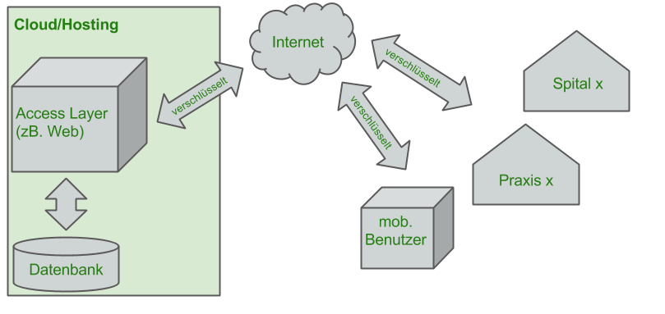
System architecture
Redundant Infrastructure
Scalable DB
SSL Encrypted data transfer
Connection to Swissmedic Search

Slide 7
Non-Functional Requirements
System Properties
System works on most of devices and browsers
Legislative / Security
A Doctor receives and stores the credentials safely
A Doctor makes sure that SSL connection is valid
A Doctor must follow the
Dependencies
Application requires persistent internet connection
Reliability
Connection to the Swissmedic search

Slide 8
System Evolution
System will be safely developed further
Modularity
Our system may grow
Apllication complexity
Cashing functionality
Scalability of DB
Browser/OS support
New browsers

Slide 9
Testing
Testing all parts of our system
Main focus:
Login & Access
Medication limits test
Usability tests
Connection to external providers (as Swissmedic)

Slide 10
Appendices
Frontend: Responsive Web Design (Desktop/Notebook, Tablet, Mobile)
GitHub Repository with Branches per Task
Web Server with Database
Regular backups
Minimal Server Configuration
1 CPU, 2 GB RAM, 50 GB HDD

